Slide 1
PHPUnit Advanced Training 2
Coding to maximize the value of unit tests

Slide 2
Agenda
Class methods organization principles
Pure functions
Dependency Injection
Refactor Walkthrough Example

Slide 3

My Style
This how I think about code. It doesn’t mean that it's the only way. Clean code takes practice and borrows from many methodologies.

Slide 4
Principle Based Coding
When we understand the principles of unit testing and clean code then we can move from ridged rule based development to a more fluid evolving approach.

Slide 5
All code does one of the following (simplified)
Reads data
Transforms data
Writes data
Coordinates the above
Decision making
Flows
Read
Transform
Write
Coordinate

Slide 6
Types of reading
Request parameters
Buffers
Database
Files
API
Services (cache)
Library or Dependency output
Memory
(more)

Slide 7
Types of transformations
Combining multiple sources
Altering
Algorithmic operations
Reducing
Filtering
(more)

Slide 8
Types of writing
HTTP Response object
Buffers
Database
Files
API
Services (cache)
Input into Libraries or Dependencies
Memory
(more)

Slide 9
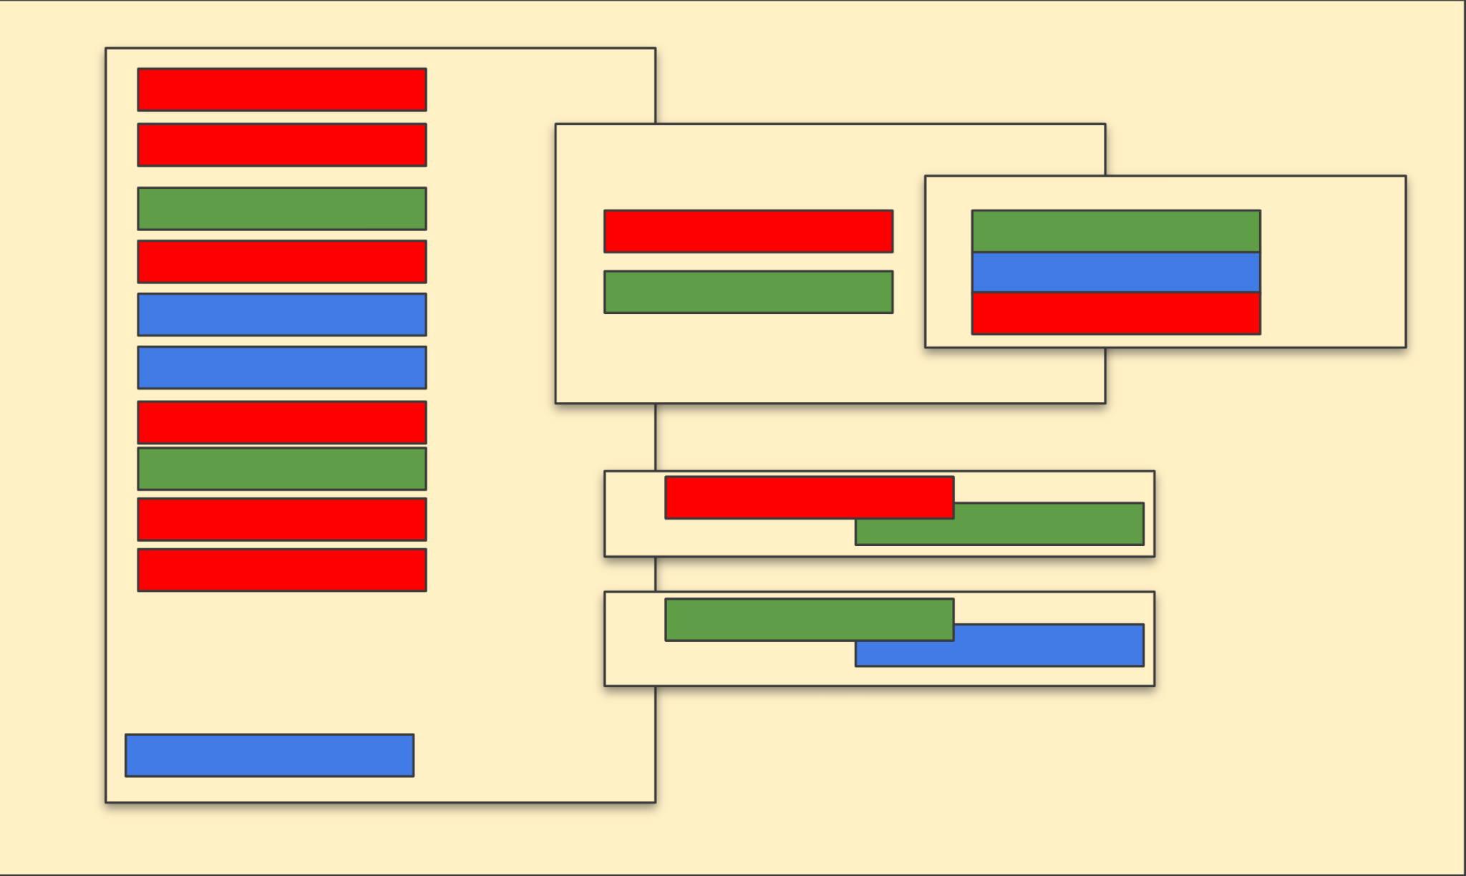
Then, we mix it all up!

Slide 10
High value vs low value
Unit tests achieve the highest value when they focus on data transformation and coordination. But achieve very little value when testing reading and writing operations.
Integration tests achieve the highest value when they focus on validating reading, writing and the coordination between resources, etc.
Integration tests
Read
Transform
High Value
Integration tests
Write
High Value
Coordinate

Slide 11
Maximize value
Method 1**
Method call
Read
By organizing your code to separate the different types of functionality (concerns), you maximize the ability to test data transformations and work flow coordination
Method 2
Method call
Transform
Method call
Method 3
Method call
Transform
Transformation verification
Behavior verification
Coordinate
Method 4**
Display
**Reading and writing are typically handled by dependencies. That’s why we mock them!

Slide 12
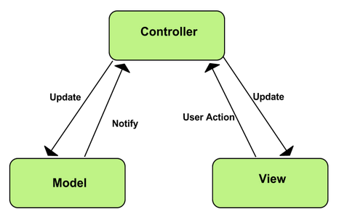
Look familiar?
Model 1
Model call
Read
MVC design patterns leverage similar methodologies.
Model 2
Model call
Transform
Model call
Model 2
Model call
Transform
Controller
View
Write

Slide 13
Balance approach
This doesn’t mean we can mix read, writes, transformations and work flows. If a method makes sense as a unit of work, then you’ve probably achieved a good balance.

Slide 14
A function is pure when:
The function return values are identical for identical arguments.
The function has no side effects (no mutation of local static variables, non-local variables, mutable reference arguments or input/output streams).
This typically means no $this, self or static

Slide 15
Pure or not?

Slide 16
Pure or not?

Slide 17
Dependency Injection (DI)
DI is a design pattern used to implement IoC. It allows the creation of dependent objects outside of a class and provides those objects to a class through different ways. Using DI, we move the creation and binding of the dependent objects outside of the class that depends on them. (source)
Constructors
Setter methods
Method parameters
Containers (the entrata way)

Slide 18
Constructor Injection
Pros:
Easy to mock
Available to all methods you want to
Cons:
You must mock it for any instance method you test

Slide 19
Setter method injection
Pros:
Easy to mock
Only necessary to mock when the instance method you are testing needs it
Cons:
Consumers of the class have an extra step needed to use the class

Slide 20
Method Injection
Pros:
Easy to update
Isolated to just one method
Cons:
Not as reusable as the other methods
Requires more injection touch points, especially if multiple methods in the same class use the same injected object.

Slide 21
Container injection

Slide 22
Container Injection (continued)
Pros:
Easy to mock
Can handle all the needed secondary dependencies
Allows for testing isolated method without mocking everything
Cons:
Only works well when the service doesn’t need multiple instances with different configurations (secondary dependencies)

Slide 23
Walkthrough

Slide 24
You CAN over-optimize

Slide 25
Signs you are over optimizing
You have more than 5~ish parameters in your method or constructor
You have many small transformation methods

Slide 26
Thanks!

